Slide 1

Word2Vec - Baby Version

Slide 2
Reference
aneesh joshi’s Blog, Code, and related Jupyter_Notebook
Zak Jost’s Blog on Noise Contrastive Estimation
NCE Paper
Chapter 14 (O'Reilly) of Hands-On ML
Youtube on Dataset used in this presentation
Youtube
Code

Slide 3
Data

Slide 4
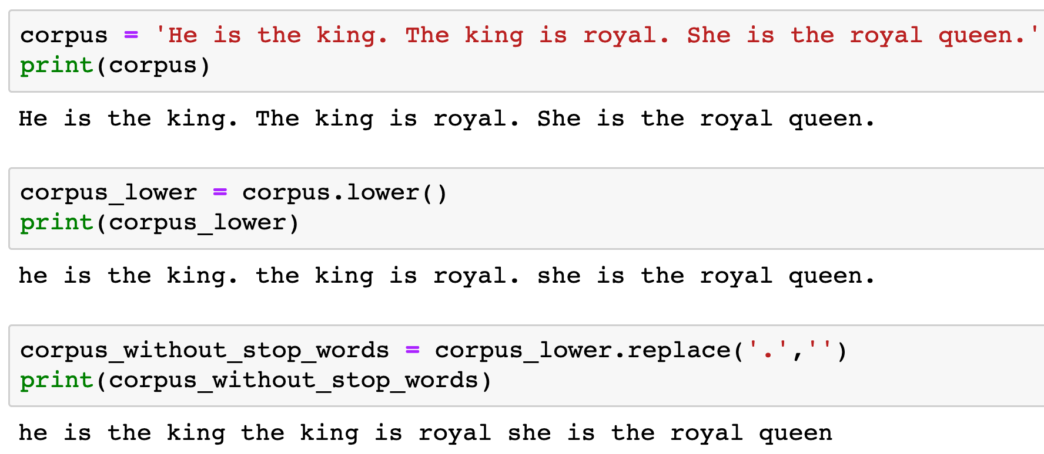


Slide 7
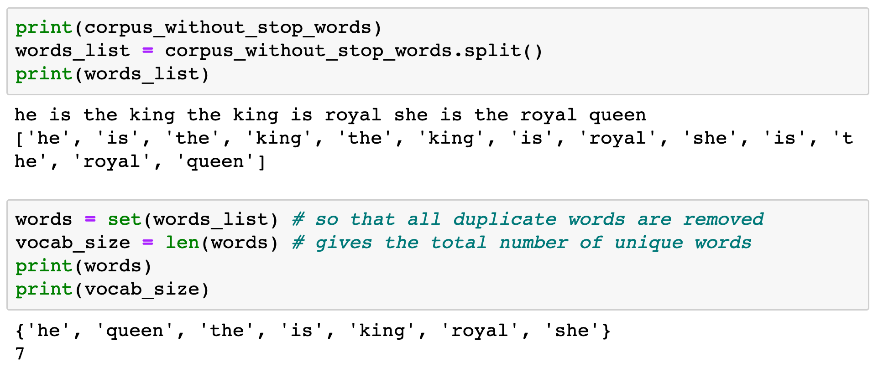


Slide 9
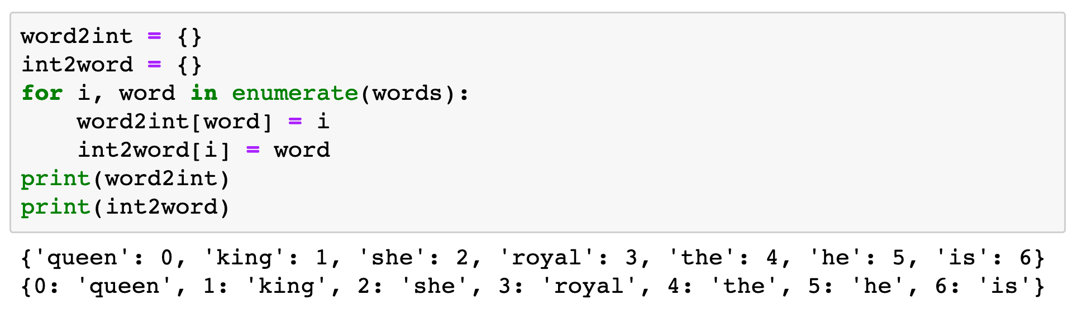

Slide 10
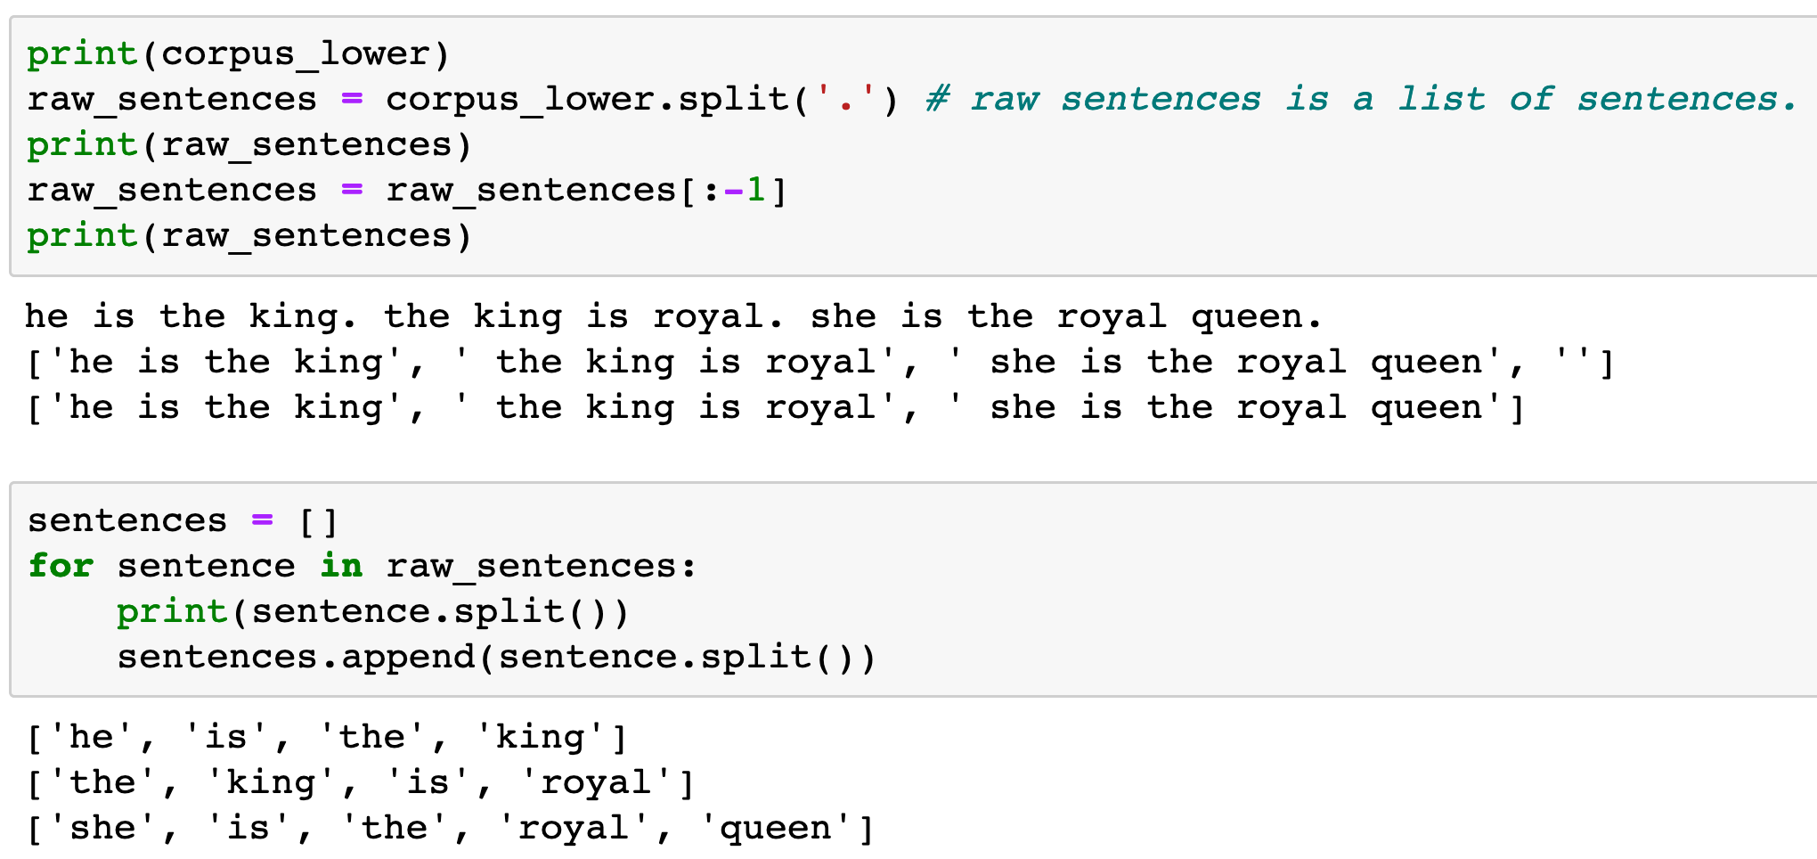

Slide 12
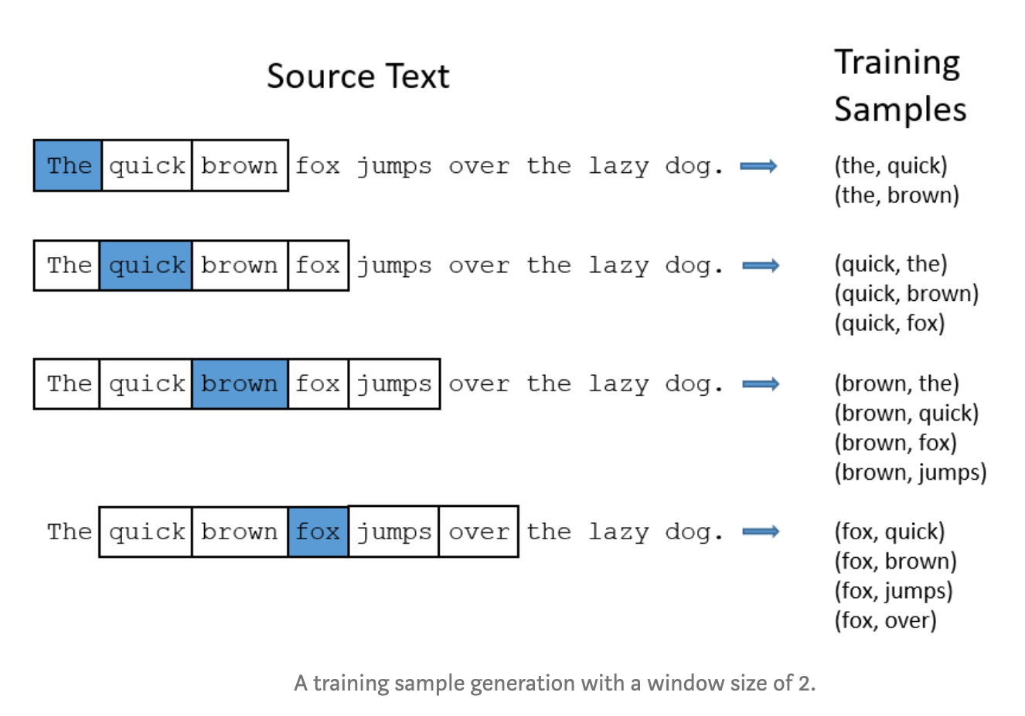
aneesh joshi’s Blog

Slide 13
aneesh joshi’s Blog
target word

Slide 14
aneesh joshi’s Blog
target word
context word

Slide 15
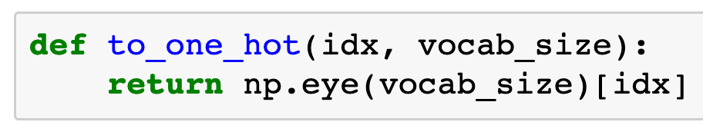

Slide 16
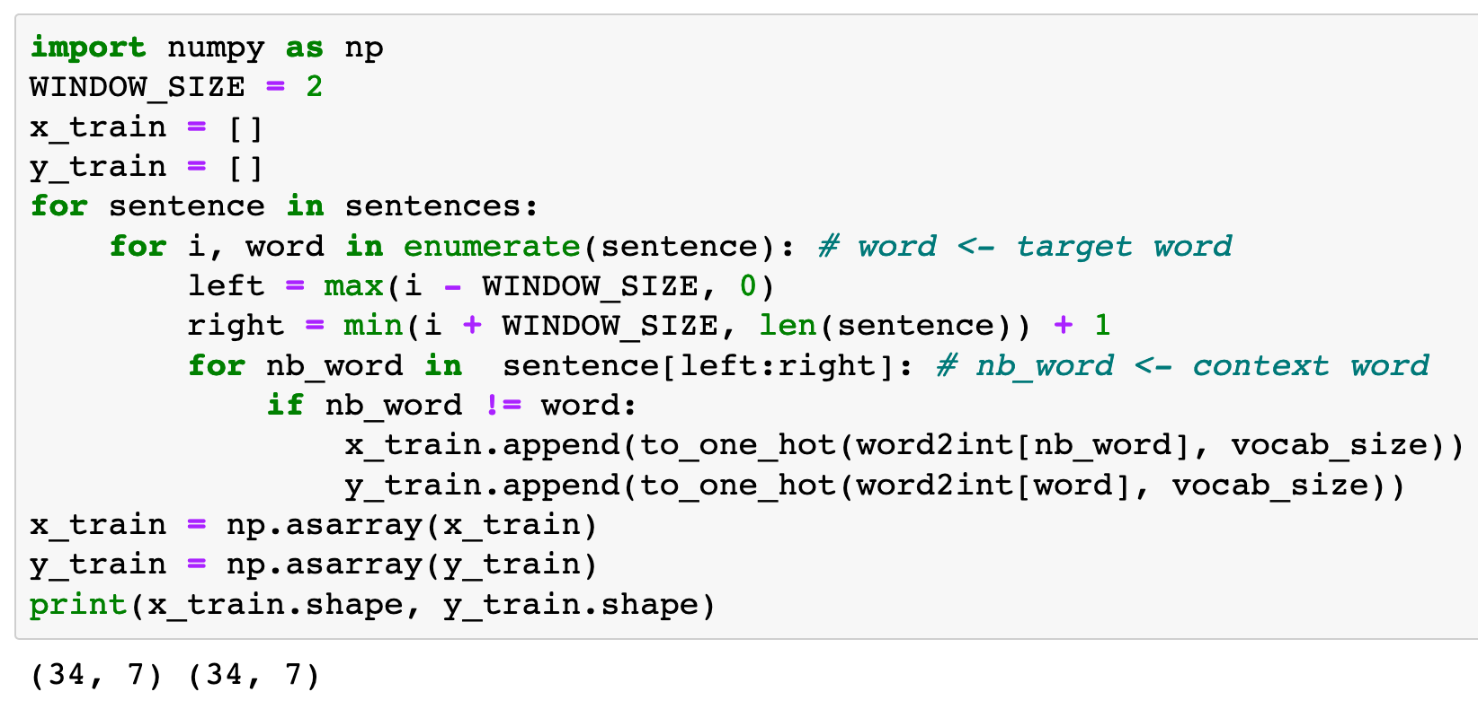

Slide 17
Graph

Slide 18
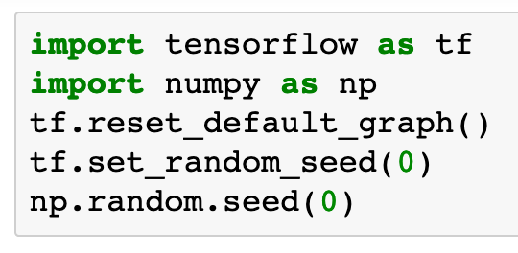

Slide 19

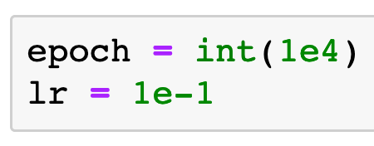

Slide 20
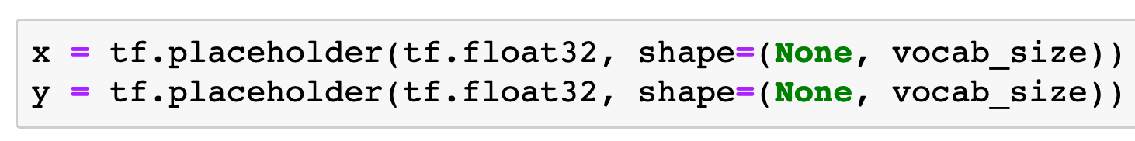

Slide 23
Ready for one hot encoding

Slide 24
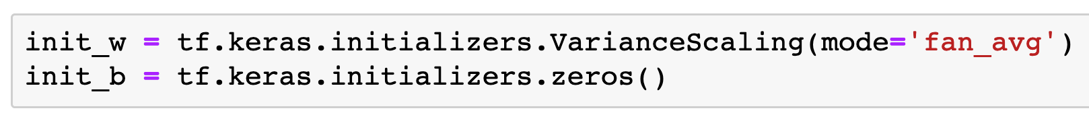

Slide 25
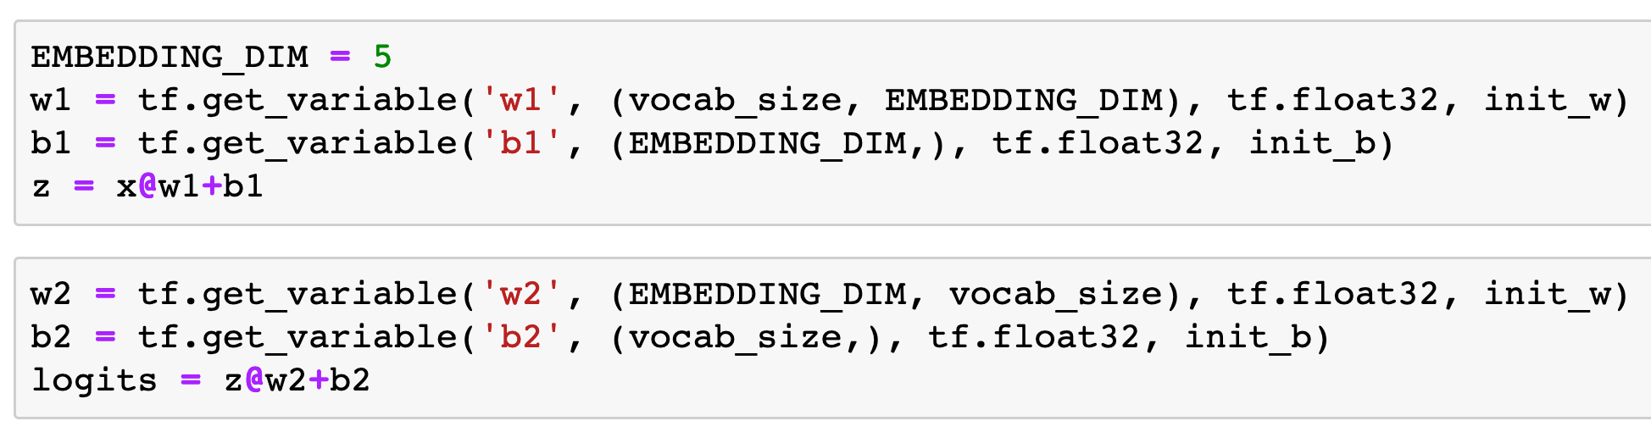
Encoding
(Embedding)
Decoding

Slide 26
Encoding
(Embedding)
Decoding

Slide 27
context word in one hot encoding
Encoding
(Embedding)
Decoding

Slide 28
context word in one hot encoding
Encoding
(Embedding)
Decoding
target word in one hot encoding

Slide 29
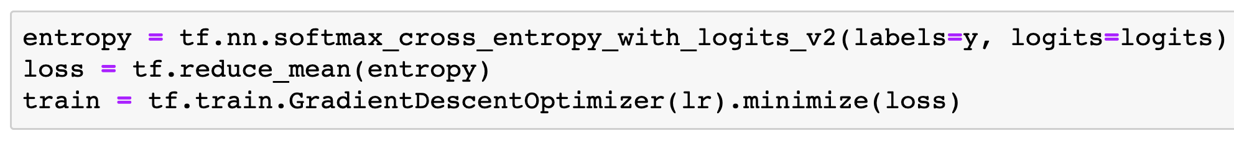

Slide 30
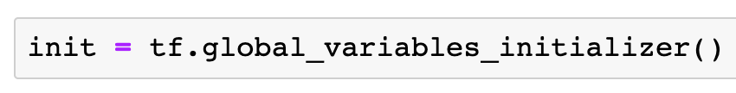

Slide 31
Session

Slide 32
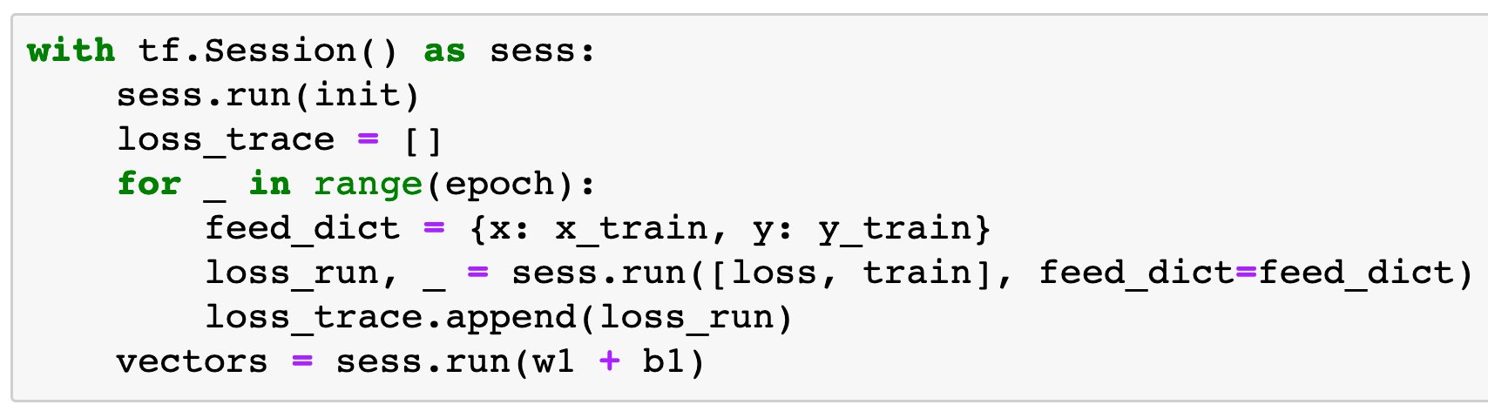
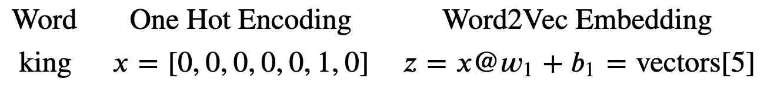
Word2Vec
Embedding

Slide 33
Word2Vec
Embedding

Slide 34
Word2Vec
Embedding

Slide 35
Word2Vec
Embedding

Slide 36
Word2Vec
Embedding

Slide 37
Report

Slide 38
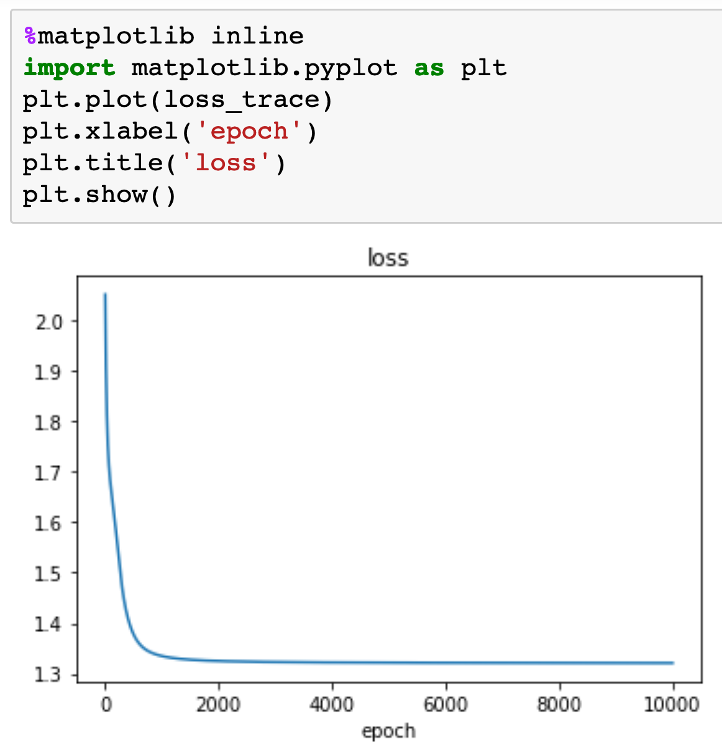

Slide 39
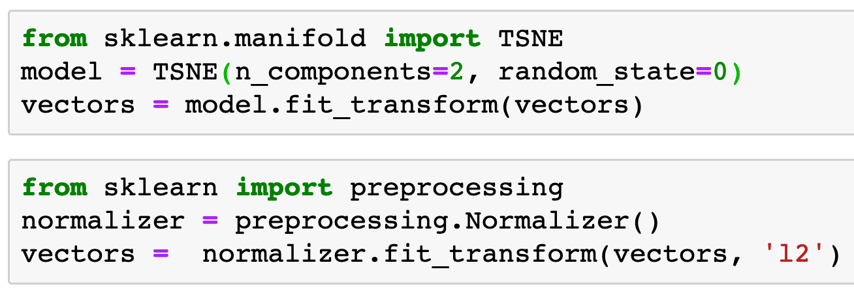


Slide 41
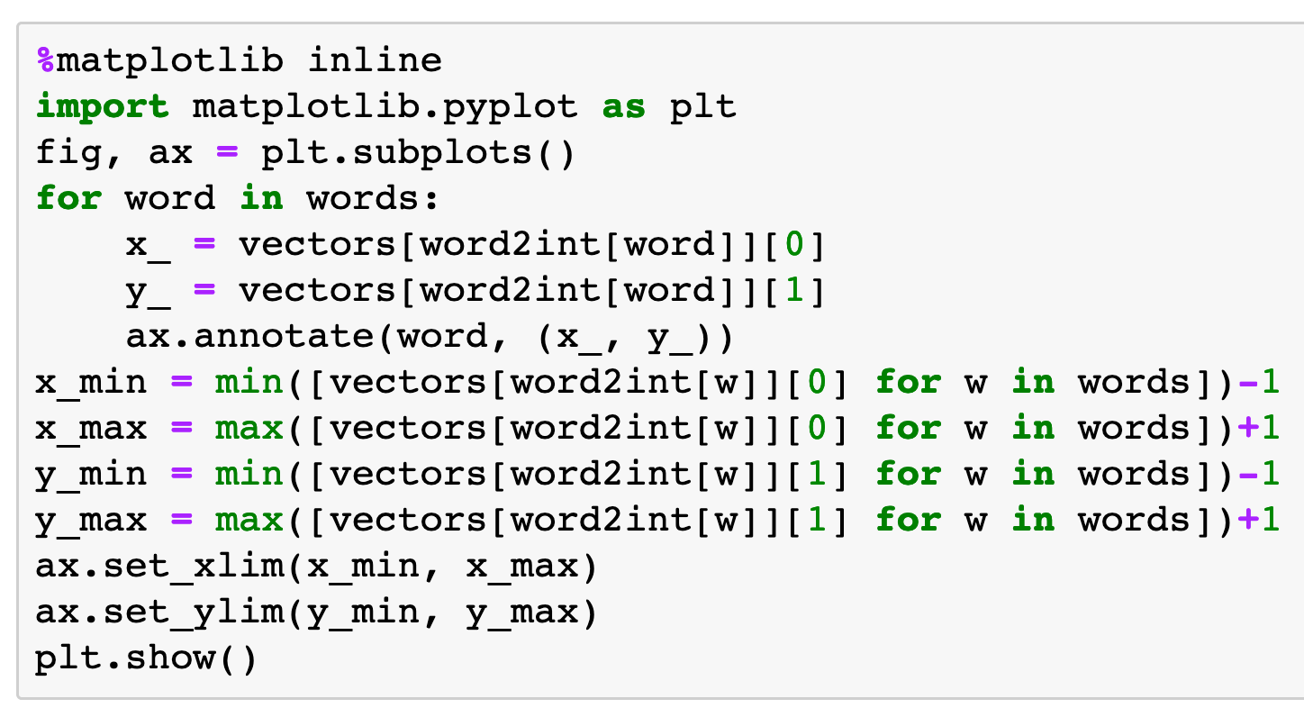

Slide 42
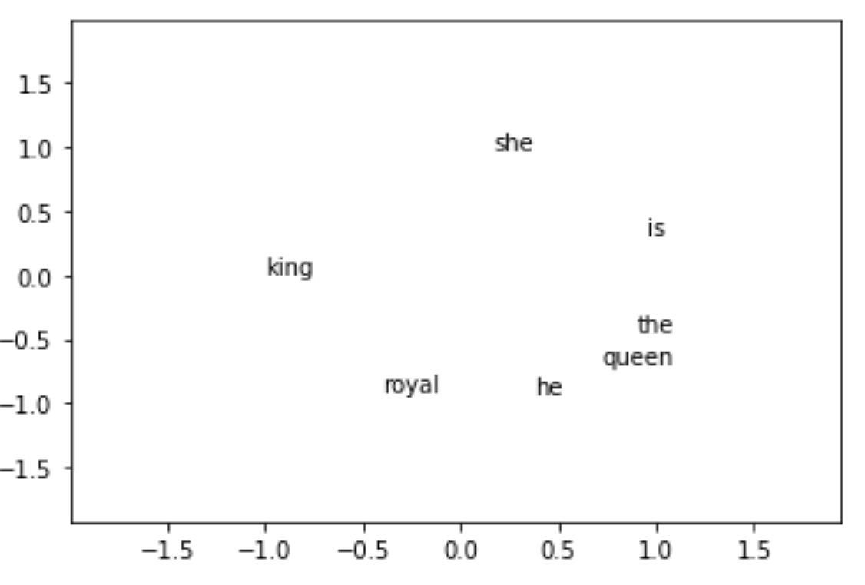

Slide 43
Now
Let’s Play with Code

